Slide 1
1 · 30 · 45 · 60
ROOTS & MIRRORS · THE RISE OF KINGDOMS · CHAPTER 14
The Youngest One There
The youngest person in the room can move first when everyone older has gone still.
1 Samuel 17:26-50 · 60 MINUTES · AGES 13+
Scripture quotations are from the ESV Bible (English Standard Version).
THE RISE OF KINGDOMS · CHAPTER 14
Notes:
Source: current Book-01 chapter markdown for Chapter 14.

Slide 2
GAME ONE · HOW IT WORKS
2 · 30 · 45 · 60
Wait or warn?
Something changes in a crowd. You notice first, and nobody older is moving. What makes you speak?
?
Know the signal
Ask for help
Trust the room
Stay quiet
Keep your answer private for now.
THE RISE OF KINGDOMS · CHAPTER 14
Notes:
Take quick answers without resolving them. The chapter will separate noticing a fact from trusting God when the danger cannot be outrun.

Slide 3
GAME ONE · THE FIRST MOVE
3 · 30 · 45 · 60
Notice what the room misses.
Write the signal, the explanation, and the move.
1
Name one strange thing a crowd might notice.
2
Name the ordinary explanation most people might choose.
3
Name what would make you act before everyone agrees.
THE RISE OF KINGDOMS · CHAPTER 14
Notes:
Keep this general. Do not let students turn it into a story about a specific person in the room.

Slide 4
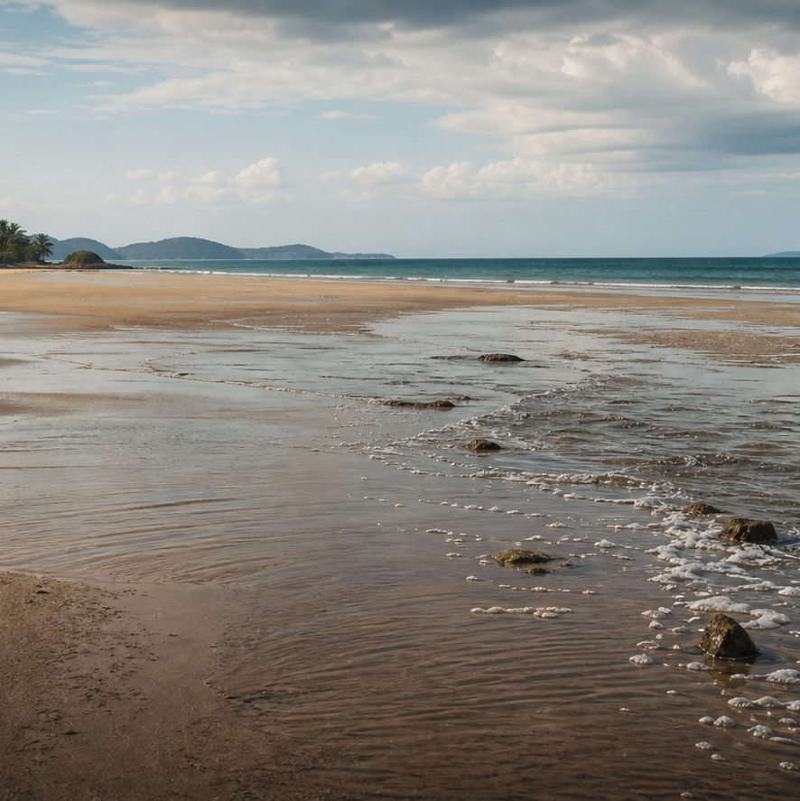
4 · 30 · 45 · 60
THE MIRROR
The water pulled back.
A ten-year-old recognized a warning while adults stood and watched.
THE RISE OF KINGDOMS · CHAPTER 14
Notes:
Source: current Book-01 chapter markdown for Chapter 14.

Slide 5
THE HOOK · THE MIRROR
5 · 30 · 45 · 60
Tilly Smith knew what she was seeing.
On December 26, 2004, Mai Khao Beach in Thailand was crowded and the sea did something strange: it pulled far back, bubbling and foaming. Adults watched. Some took photos. Tilly Smith was ten. Two weeks earlier, a geography lesson had taught her that a retreating, foaming sea can come before a tsunami. She told her mother, kept insisting, and got the hotel staff moving. Minutes later the water returned as a wall. Around a hundred people walked away because the youngest person there refused to stay quiet.
She did not have authority. She had seen the signal before.
THE RISE OF KINGDOMS · CHAPTER 14
Notes:
Tell the story from the current chapter markdown. Keep the focus on recognition and speaking up, not on making a child responsible for rescuing everyone.

Slide 6
THE HOOK · THE HINGE
6 · 30 · 45 · 60
The signal came before the wave.
Tilly carried a lesson from an ordinary classroom into an extraordinary moment.
10
2 weeks
1
years old
since the lesson
person who kept insisting
Knowing what the moment means can make your voice necessary.
THE RISE OF KINGDOMS · CHAPTER 14
Notes:
The chapter says Tilly was ten, had learned the warning two weeks earlier, and was the only person on the sand who understood what she was seeing. Keep the claims bounded to that account.

Slide 7
TALK · CALL THEM OUT
7 · 30 · 45 · 60
Signal or spectacle?
?
What makes a strange thing worth interrupting the room for?
Answer with the difference between noticing and knowing.
THE RISE OF KINGDOMS · CHAPTER 14
Notes:
Take two or three answers. Do not solve the question yet; David will force the distinction further.

Slide 8
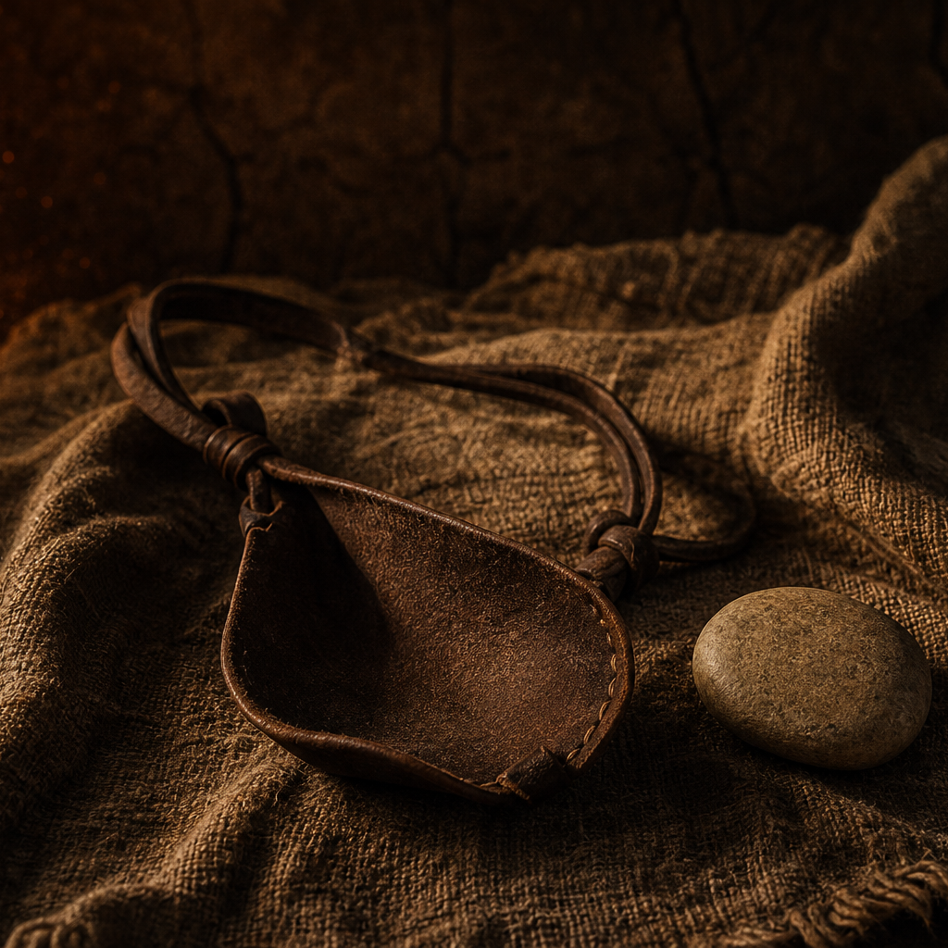
8 · 30 · 45 · 60
THE BOOK
The youngest one in the army.
1 Samuel 17:26-50 · David hears the question nobody older will answer.
THE RISE OF KINGDOMS · CHAPTER 14
Notes:
Source: current Book-01 chapter markdown for Chapter 14.

Slide 9
THE BOOK · SET THE SCENE
9 · 30 · 45 · 60
David was not supposed to be the answer.
For forty days Goliath had challenged Israel. Saul and the trained army heard him and did nothing. David arrived with food for his older brothers. He was the youngest son, not a soldier. He asked the obvious question: why is no one answering this man? Eliab called it presumption. David kept talking until Saul heard him.
1 SAMUEL 17:26-37 · ESV
THE RISE OF KINGDOMS · CHAPTER 14
Notes:
Set the contrast plainly. David is not introduced as the most qualified person in the room. He is the one who refuses to call forty days of fear normal.

Slide 10
THE BOOK · BEFORE WE READ
10 · 30 · 45 · 60
What should David do next?
A boy has no rank, no armor training, and no promise that the army will follow him. The giant is waiting.
A · WAIT FOR THE TRAINED
B · STEP FORWARD
Let the soldiers handle it. They know more, and the risk belongs to them.
Say what you know, trust God, and face the thing everyone else is avoiding.
Choose before the text answers.
THE RISE OF KINGDOMS · CHAPTER 14
Notes:
Hands vote, no discussion, then read. The text answers B, but do not make A sound foolish. Waiting for someone more qualified is often the safer-looking choice.

Slide 11
READ ALOUD · ONE VOICE
11 · 30 · 45 · 60
1 SAMUEL 17:37 · ESV
The LORD who delivered me from the paw of the lion and from the paw of the bear will deliver me from the hand of this Philistine.
David's confidence was built in an empty field before it was tested in public.
THE RISE OF KINGDOMS · CHAPTER 14
Notes:
Read the rescue history before the giant answer. David is not guessing who God is; he is remembering who God has been.

Slide 12
THE BOOK · BEAT 1
12 · 30 · 45 · 60
1
He noticed what everyone else normalized.
Forty days of the same threat had made fear feel like the weather. David heard the words and asked why the whole army had accepted them. He was not the most qualified person in the room. He was the one who refused to call paralysis normal.
Sometimes the first act of courage is asking the obvious question.
THE RISE OF KINGDOMS · CHAPTER 14
Notes:
Keep this beat about the room's frozen response, not about shaming frightened people. The point is what David did with what he noticed.

Slide 13
THE BOOK · BEAT 2
13 · 30 · 45 · 60
2
He carried old rescues into a new fight.
David did not build courage from the size of Goliath. He remembered a lion, a bear, and the LORD who had delivered him. The empty field had prepared him for the public valley.
What God carried you through before is not wasted history.
THE RISE OF KINGDOMS · CHAPTER 14
Notes:
Connect verse 37 to the ordinary work nobody saw. Invite students to remember small faithfulness, not manufacture a dramatic testimony.

Slide 14
THE BOOK · BEAT 3
14 · 30 · 45 · 60
3
He moved with what he had.
Saul's armor did not fit, so David took it off. He used the sling and stones he knew. Faith did not make him pretend to be someone else, and preparation did not replace trust.
The right preparation helps you move as yourself.
THE RISE OF KINGDOMS · CHAPTER 14
Notes:
Do not teach this as a promise that the familiar tool always wins. The chapter's point is that David did not borrow an identity for the moment.

Slide 15
THE HINGE · WHAT THE PAIRING SHOWS
15 · 30 · 45 · 60
A fact can make you speak. Trust can make you step.
THE SHARED MECHANISM
THE DIFFERENCE THAT MATTERS
Tilly and David were the youngest or least-authoritative people in a room that had gone still. Both carried something learned earlier into a moment nobody had planned for. Both refused to stay quiet.
Tilly's courage came from recognizing a fact. The beach could be evacuated. David's danger could not be outrun. He needed trust in the One who had already been faithful when nobody else was watching.
Notice what the moment means. Remember who has been faithful. Then move.
THE RISE OF KINGDOMS · CHAPTER 14
Notes:
State the disanalogy clearly. Tilly and David are not interchangeable heroes. The shared mechanism is prepared recognition; the difference is the source and kind of courage the moment required.

Slide 16
16 · 30 · 45 · 60
LOOK
What are you carrying?
?
Groups of three to five. Start with the signals, then turn toward trust.
THE RISE OF KINGDOMS · CHAPTER 14
Notes:
Source: current Book-01 chapter markdown for Chapter 14.

Slide 17
TALK · CALL THEM OUT
17 · 30 · 45 · 60
The youngest in the room
?
Where do you stay quiet because someone older, louder, or more official is already there?
Name the room, not the person.
THE RISE OF KINGDOMS · CHAPTER 14
Notes:
Keep this safe and general. Students do not need to identify a real adult or disclose a current danger in front of the group.

Slide 18
TALK · CALL THEM OUT
18 · 30 · 45 · 60
Fact or trust?
?
What is something you can handle with what you know? What is something you can only face by trusting God?
Keep the two answers separate.
THE RISE OF KINGDOMS · CHAPTER 14
Notes:
Help students avoid turning faith into anti-information. Tilly needed a fact. David needed trust for a danger that had to be faced.

Slide 19
TALK · CALL THEM OUT
19 · 30 · 45 · 60
Your lions and bears
?
What small rescue, answered prayer, or faithful moment do you need to remember before your next giant?
Name one thing that is easy to forget.
THE RISE OF KINGDOMS · CHAPTER 14
Notes:
A small answer is enough. Do not pressure students to share a dramatic story.

Slide 20
YOUR MOVE · DO THIS TODAY
20 · 30 · 45 · 60
The Signal Card
Notice it.
Name it.
Move.
Write one situation where you may be the youngest, newest, or least official person in the room. Name what you already know to do. Then name the part that cannot be handled by information alone. Choose one person you trust and one step you will take this week. If the situation involves real danger or harm, tell a trusted adult instead of handling it alone.
One specific action.
THE RISE OF KINGDOMS · CHAPTER 14
Notes:
Cards stay private. The trusted-adult sentence is a safety valve, not a detour. Keep the action small and specific.

Slide 21
YOUR MOVE · ONE CARD, THREE LINES
21 · 30 · 45 · 60
Three lines before the giant.
A fact may start your voice. Trust helps move your feet.
1
The signal I need to notice is...
2
What I can handle with what I know is...
3
The part I need to trust God with is...
THE RISE OF KINGDOMS · CHAPTER 14
Notes:
Give students quiet while they write. They may keep the card private. Encourage a concrete situation rather than a vague life goal.

Slide 22
22 · 30 · 45 · 60
CLOSE
You might be the youngest one there.
That is not the disqualification you think it is. Notice what the moment means, remember who has carried you, and take the next safe step.
ROOTS & MIRRORS
THE RISE OF KINGDOMS · CHAPTER 14
Notes:
Close in prayer for courage to speak when the room has gone still, wisdom to know the difference between a signal and a spectacle, and trust for the giants that cannot be outrun.

